Slide 1

Flight Price Prediction Project
Submitted by :
G. Premsagar (Data Science Intern at Flip Robo Technologies)

Slide 2

INTRODUCTION
Business requirement

Slide 3
PROBLEM STATEMENT
The airline industry is considered as one of the most sophisticated industry in using complex pricing strategies. Nowadays, ticket prices can vary dynamically and significantly for the same flight, even for nearby seats. Anyone who has booked a flight ticket knows how unexpectedly the prices vary. The cheapest available ticket on a given flight gets more and less expensive over time. This usually happens as an attempt to maximize revenue based on
1. Time of purchase patterns (making sure last-minute purchases are expensive).
2. Keeping the flight as full as they want it (raising prices on a flight which is filling up in order to reduce sales and hold back inventory for those expensive last-minute expensive purchases).

Slide 4
PHASES OF THE PROJECT
This project is done in three parts:
- Data Collection
- Data Analysis
Model Building
I created two different Jupyter Notebook files to performed the required actions.
As per the requirement of client, I have scrapped the data from online sites and based on that data I have performed analysis like based on which feature of my data does flight prices change and checked the relationship of flight prices with all the other features to get a gist on what flight a passenger should choose.

Slide 5
JUPYTER NOTEBOOK USAGE
Web Scraping
Wrote code to collect data
Ensured the data collected is legitimate and valid
Machine Learning
Performed Data cleaning, EDA, Visualization etc.
Created multiple models and hyper tuned them
For two independent files, I used Python programming in Jupyter Notebook.
The first notebook was used to write the code for extracting flight prices and details from various web pages and saving them in a comma separated value file.
The second notebook was used to develop a Flight Price Prediction project and explore various strategies to improve anticipated outcomes.

Slide 6
MODEL BUILDING STEPS
1. Data Cleaning
2. Exploratory Data Analysis
3. Data Pre-processing
4. Model Building
5. Model Evaluation
6. Selecting the best model

Slide 7
DATA SCIENCE LIFE CYCLE
Data Cleaning
Import the collected data from web scraping
Exploratory Data Analysis
Check through all the dataset information like datatype, missing value, duplicate value etc.
Visualization and Data Preprocessing
Use various visualization methods to check the data distribution identify presence of outliers and skewness
Clean and format the records as per usage by using various imputation techniques
Analyze each and every data record to ensure we have usable information
Perform encoding and scaling methods

Slide 8
DATA SCIENCE LIFE CYCLE
Model Building
Create appropriate Regression Machine Learning model function
Model Evaluation
Usage of evaluation metrics to check the accuracy of the models over trained and test data inputs
Hyperparameter Tuning Best Model
Choosing the appropriate Regression Machine Learning model to check various parameter permutation and combinations
Need to ensure that whenever the regression function is called it is able to process all the necessary parameters
Ensure the cross validation techniques helps in reducing over fitting and under fitting data
Using Grid Search CV to obtain the best parameters that can be plugged into the selected model

Slide 9
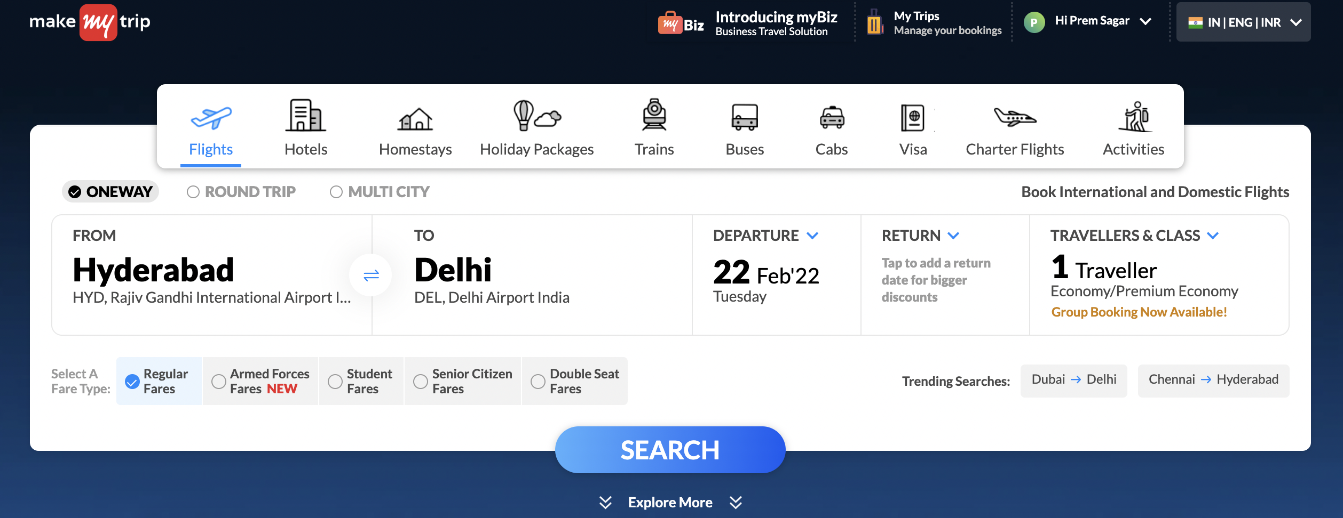
WEB SCRAPING WEBPAGES FOR FLIGHTS

Slide 10
DATA PREPROCESSING
Importing the necessary dependencies and libraries.
Reading the CSV file and converted into data frame.
Checking the data dimensions for the original dataset.
Looking for null values and accordingly renaming the values.
Checking the summary of the dataset.
Checking unique values.
Checking all the categorical columns in the dataset.
Ensuring that the values are good to use and discarding junk data.

Slide 11
DATA PREPROCESSING
Visualizing with the use of pandas profiling feature.
Visualizing each features using matplotlib and seaborn.
Performing encoding using the ordinal encoder on categorical features.
Checking for co-relation/multi-collinearity in a heatmap.
Checking for Outliers/Skewness using boxen plot and distribution plot.
Checking for the final dimension of dataset to confirm the input details.
Creating train test split and the best random state found in the range 1-1000.
Taking a look at the importance of feature details to analyse further.

Slide 12
TECHNOLOGY USED
Hardware technology being used:
CPU : MacBook Pro, M1 Chipset
RAM : 8 GB
GPU : 8GB
Software technology being used:
Programming language : Python
Distribution : Anaconda Navigator
Browser based language shell : Jupyter Notebook
Libraries/Packages specifically being used:
Pandas, NumPy, matplotlib, seaborn, scikit-learn, pandas-profiling, missingno

Slide 13
EXPLORATORY DATA ANALYSIS (EDA) AND VISUALIZATION
Univariate Analysis
Univariate analysis is the simplest form of analyzing data. “Uni” means “one”, so in other words your data has only one variable.
Multivariate Analysis
Multivariate analysis is a set of statistical techniques used for analysis of data that contain more than one variable.
Correlation of Dataset
Correlation is used to test relationships between quantitative variables or categorical variables.
Correlation with Target variable
Conclusion
Correlation with the target variable to know how the data is related.
Summary with the conclusion of all the analysis.

Slide 14
EXPLORATORY DATA ANALYSIS (EDA)
First I have imported the necessary libraries and loaded the entire dataset in our Jupyter Notebook and renamed the project file from untitled.
Then I checked the shape of our dataset and found that we have a total of 1,829 rows and 8 different columns.
We don’t have any null values or missing values present in our dataset from the web scraping.
By checking the data types I came to know that our data set consists of columns having only object datatype even those there were numeric information present.

Slide 15
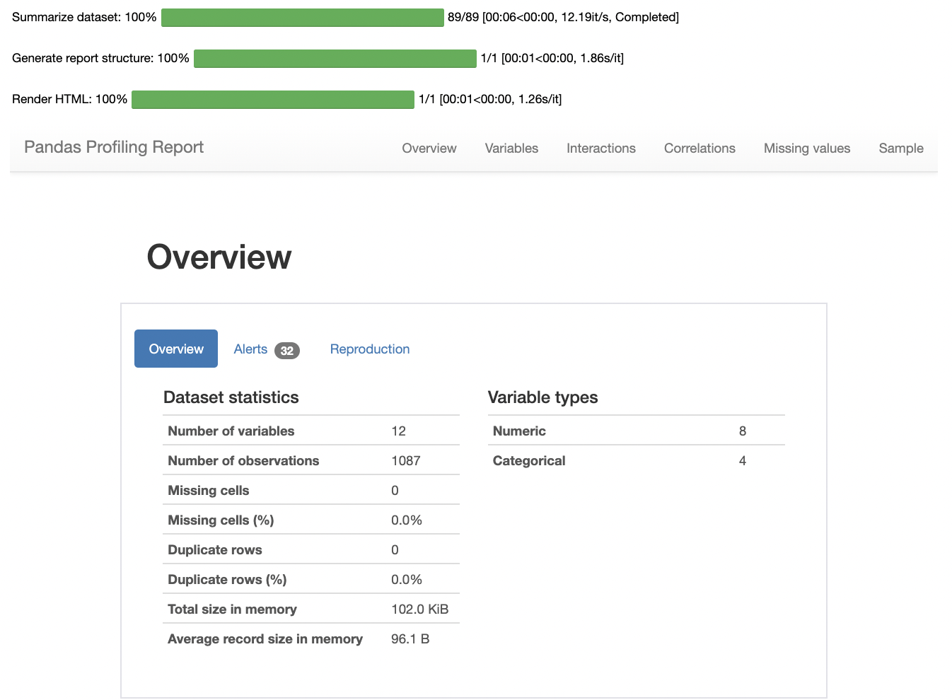
VISUALIZATION USING PANDAS PROFILING REPORT
Here I have made use of pandas profiling to get a gist of my pre processed data and get a insight on the basic overview of my dataset values.

Slide 16
COUNT PLOTS
“““

Slide 17
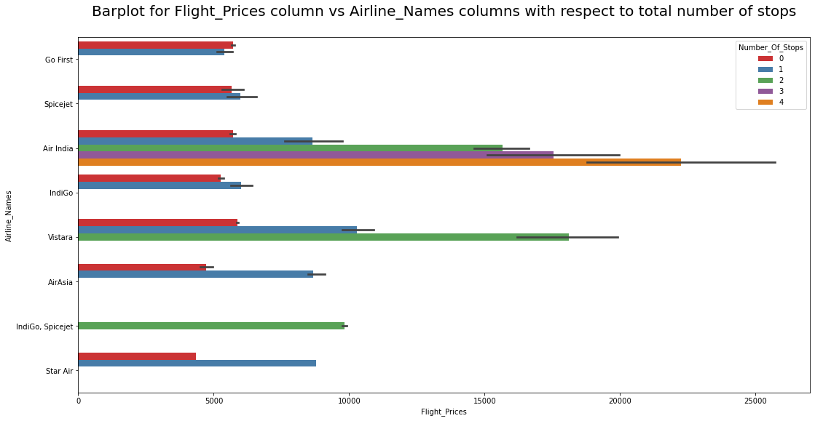
BAR PLOTS
“““

Slide 18
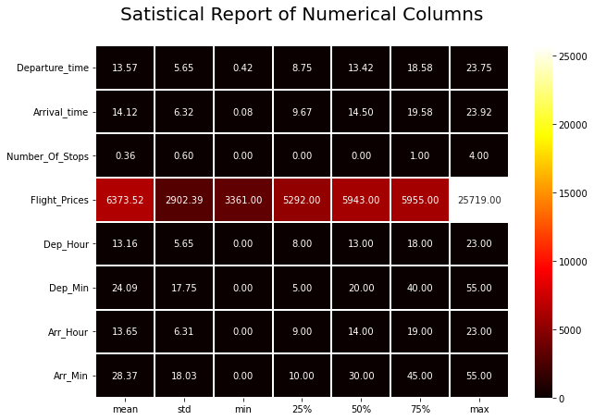
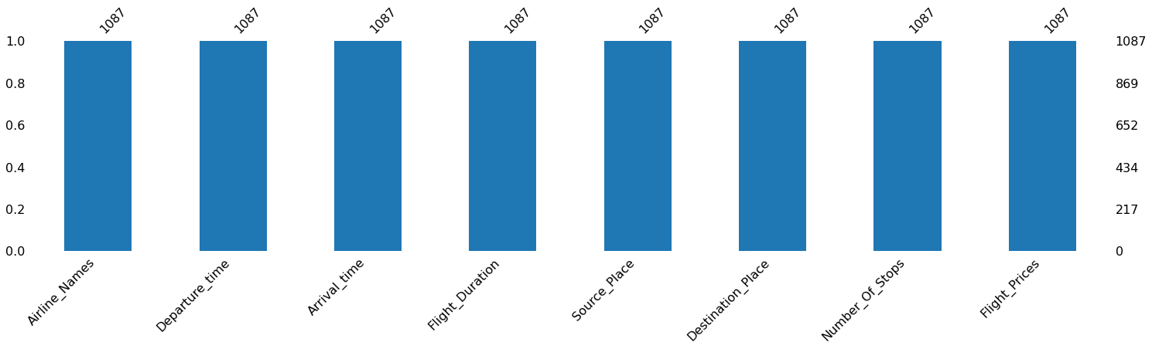
MISSING VALUES AND DESCRIBE DATA
“““

Slide 19
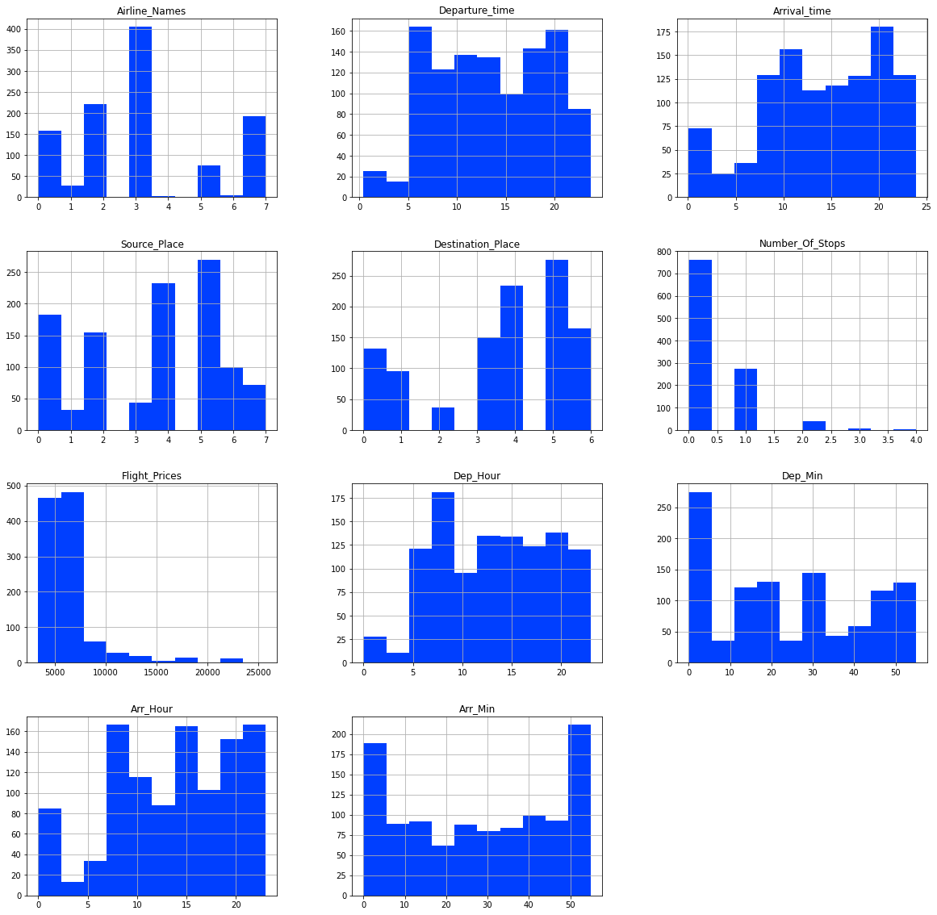
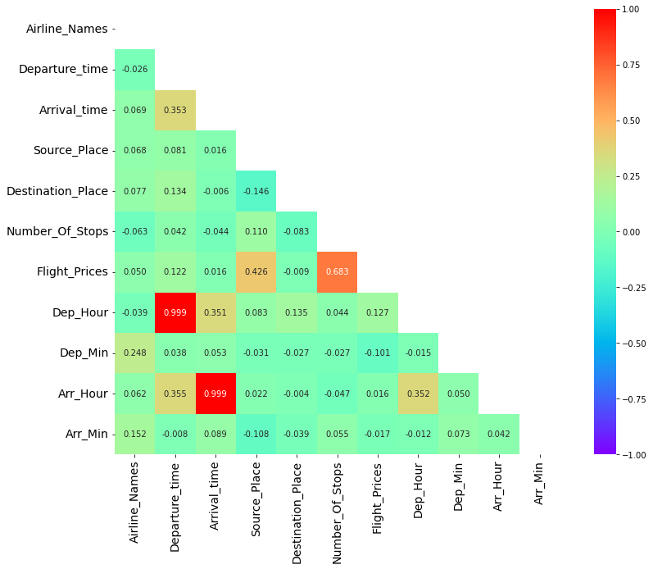
HISTOGRAM AND HEATMAP
“““

Slide 20
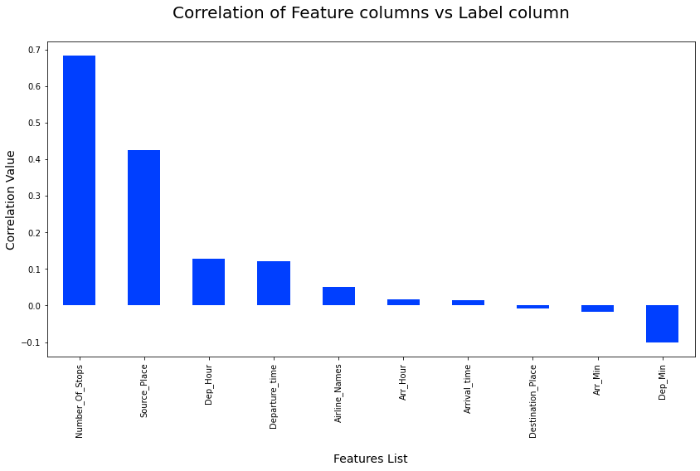
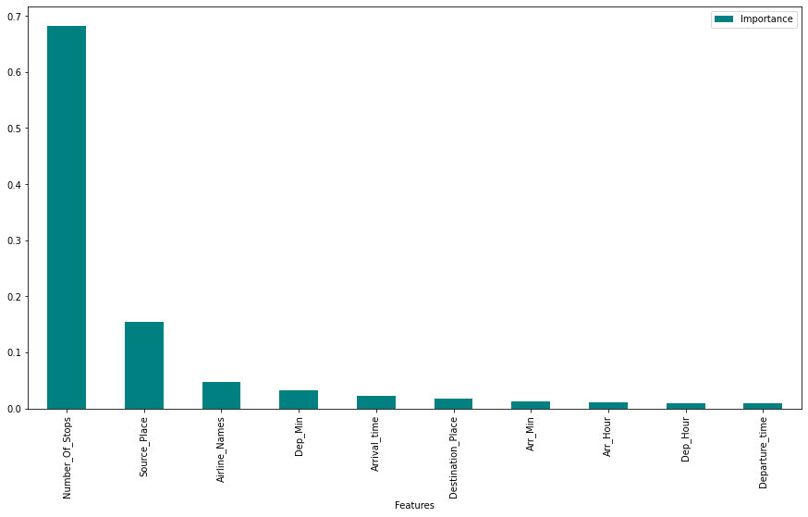
CORRELATION AND IMPORTANCE BAR GRAPHS
“““

Slide 21
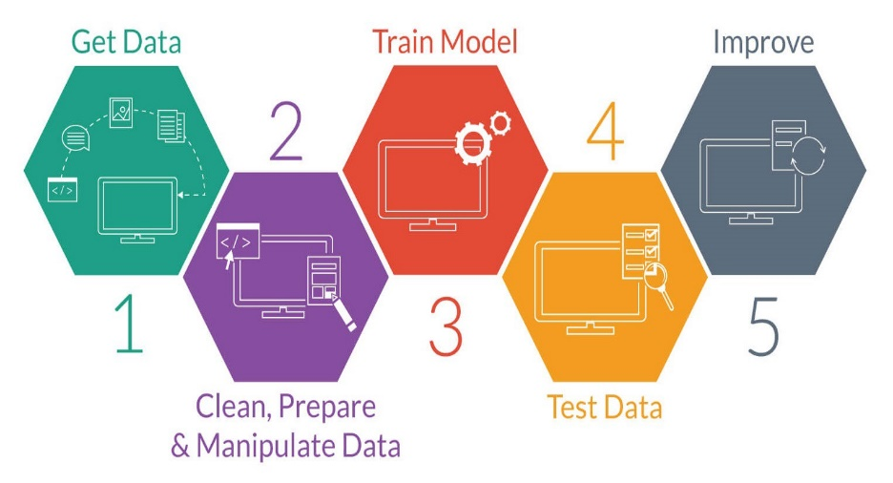
MODEL TRAINING PHASES
“““

Slide 22
REGRESSION MACHINE LEARNING MODEL/S USED
“““
▪ Linear Regression Model
▪ Ridge Regularization Model
▪ Lasso Regularization Model
▪ Support Vector Regression Model
▪ Decision Tree Regression Model
▪ Random Forest Regression Model
▪ K Neighbours Regression Model
▪ Gradient Boosting Regression Model
▪ Ada Boost Regression Model
▪ Extra Trees Regression Model

Slide 23
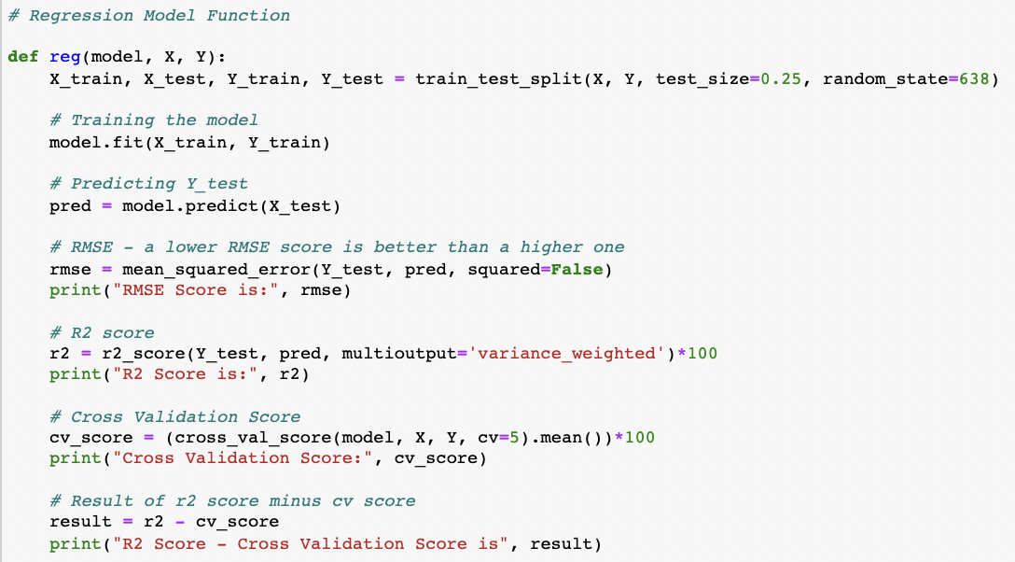
REGRESSION MODEL FUNCTION WITH EVALUATION METRICS
“““

Slide 24
RESULT OF MULTIPLE REGRESSION MODELS
“““

Slide 25
EVALUATION AND HYPER PARAMETER TUNING
The key metrics used here were:
R2 score
Cross Validation Score
MAE
MSE
RMSE
We tried to find out the best parameters list to increase our accuracy scores by using Hyperparameter Tuning. In order to achieve a higher score we used the Grid Search CV method with 5 folds.

Slide 26
INFERENCE
Concluding the project outcome

Slide 27
KEY FINDINGS AND CONCLUSIONS OF THE STUDY
We grabbed flight data from airline websites for our research. The data frame is then loaded with the comma separated value file. Fortunately, our data collection does not include any missing values. Looking at the data collection, we see that various aspects must be processed, such as converting data types and extracting the actual value from string entries in time-related columns. I used EDA to understand the relationship between characteristics and the target variable once the data was processed. Travel duration, number of stops along the way, and food availability all have a part in determining flight pricing.
As we can see, the forecast and the actual price from the scrapped data set have a similar connection. This indicates that the model anticipated properly, and it may be able to assist airlines in determining what pricing they can keep. It may also assist clients in predicting future flight rates and planning their travel appropriately, as it is difficult for airlines to maintain pricing as they fluctuate owing to many factors. As a result, we can tackle this problem by employing Machine Learning approaches.
The aforementioned research will assist our customer in studying the most recent flight price market, and with the model established, he will be able to easily forecast the price ranges of the flight, as well as understand how the flight price is determined.

Slide 28
LEARNING OUTCOMES OF THE STUDY IN RESPECT OF DATA SCIENCE
The data visualisation section assisted me in understanding the data by providing a graphical depiction of large amounts of data.
It helped me comprehend the relevance of features, outliers, and skewness detection, as well as comparing independent and dependent features.
Because data cleansing is the most crucial element of model construction, I made sure the data was clean before starting.
I created several regression machine learning models in order to find the best one, and Extra Trees Regressor Model was the best based on the metrics I utilised.
I made certain that I got at least a reasonable forecast confidence %.

Slide 29
LIMITATIONS OF THIS WORK AND SCOPE FOR FUTURE WORK
Some algorithms have issues with overfitting, which might be due to the reduced amount of features in our dataset.
The study's limitation is that we collected data in a dynamic shifting market; to be more specific, we collected data during the pandemic and more current data, so after the epidemic is over, the market may adjust slowly.
As a result, the decisive criteria may alter, and we have picked and collected data from the most essential cities across India.
If the consumer is from a foreign nation, our algorithm may be unable to anticipate the flight's accurate price.

Slide 30


